Slide 1


Introduction to International Women's Day
International Women's Day is celebrated annually on March 8. It is a day to recognize the achievements and contributions of women, as well as to raise awareness about gender equality and women's rights.

Slide 2
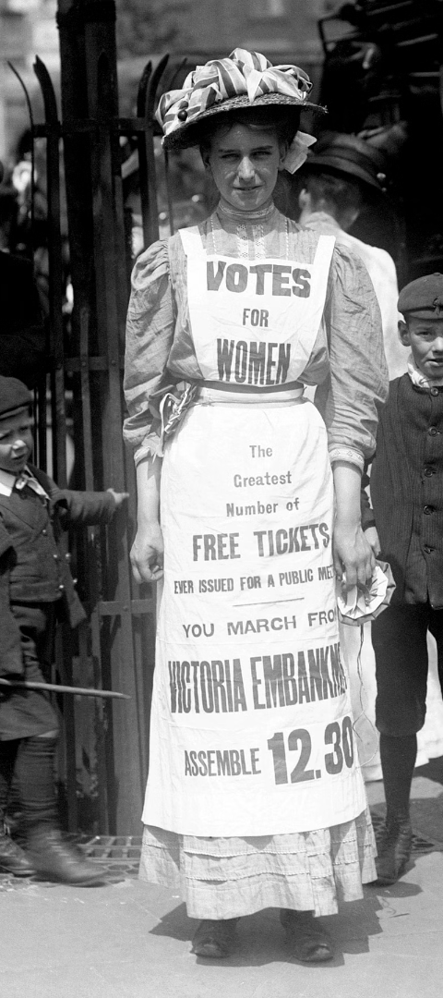
History and Significance of International Women's Day
1
Origins
International Women's Day was first celebrated in 1911 and is rooted in women's rights movements.
2
Recognition
It became a globally recognized event after it was adopted by the United Nations in 1975.
3
Global Impact
Today, it serves as a symbol of the ongoing struggle for gender equality and women's empowerment worldwide.

Slide 3

Achievements and Progress Made by Women
1
Advancements in STEM
2
Political Leadership
Women have made significant strides in science, technology, engineering, and mathematics fields.
More women are holding political offices, breaking barriers and advocating for change.
3
Cultural Influence
Women have played a pivotal role in shaping art, literature, and cultural movements.

Slide 4
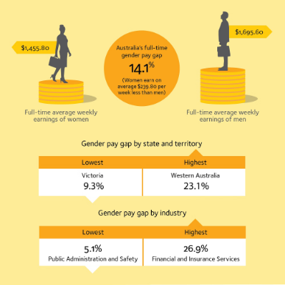


Challenges and Obstacles Faced by Women
Gender Pay Gap
Violence Against Women
Underrepresentation
Women often earn less than men for the same work, perpetuating economic disparities.
Domestic violence, sexual assault, and harassment are pervasive issues affecting women globally.
Women are underrepresented in leadership positions and decision-making roles.

Slide 5
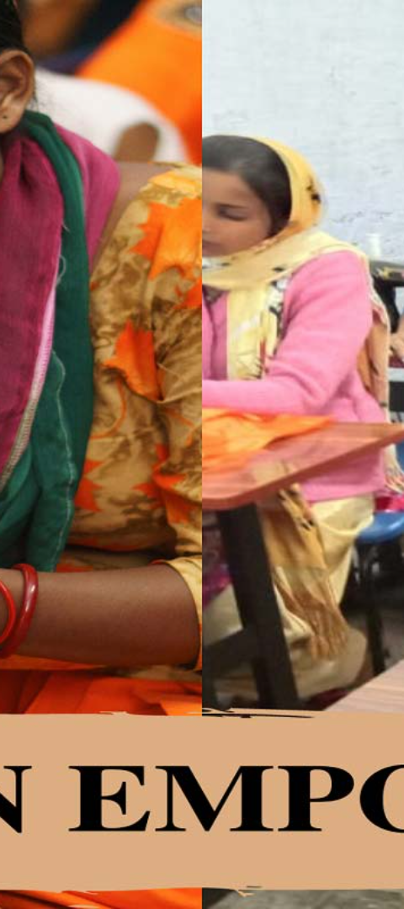



Empowering Women Through Education and Employment
Equal Access to Education
Providing girls and women with educational opportunities is essential for their empowerment.
Career Development
Supporting professional growth through mentorship, training, and equal employment opportunities.
Financial Independence
Empowering women economically leads to greater independence and decision-making power.

Slide 6

Promoting Gender Equality and Women's Rights
Legal Reform
Cultural Change
Advocating for gender-sensitive laws to protect women's rights and ensure equality.
Challenging stereotypes and promoting positive images of women in media and society.
Healthcare Access
Ensuring access to comprehensive healthcare services, including reproductive rights.

Slide 7




Celebrating Women's Achievements and Contributions
Recognizing Excellence
Inspiring Leadership
Diversity in Strength
Unity and Solidarity
Honoring women's achievements in various fields and industries.
Celebrating women who lead by example and inspire others.
Embracing the diversity of women's experiences and expertise.
Bringing together women from all walks of life to celebrate their collective strength.

Slide 8
Call to Action: How We Can All Support and Uplift Women
Education
Equal Opportunities
Education Initiatives
Advocating for Equality
Supporting programs that promote access to education for girls and young women.
Promoting policies and practices that ensure equal opportunities for women in all spheres.
Empowerment
Inclusion
Empowering Through Work
Building Inclusive Communities
Creating opportunities and support systems for women to thrive in their careers.
Fostering environments that uplift and include diverse voices and experiences.

